Slide 1
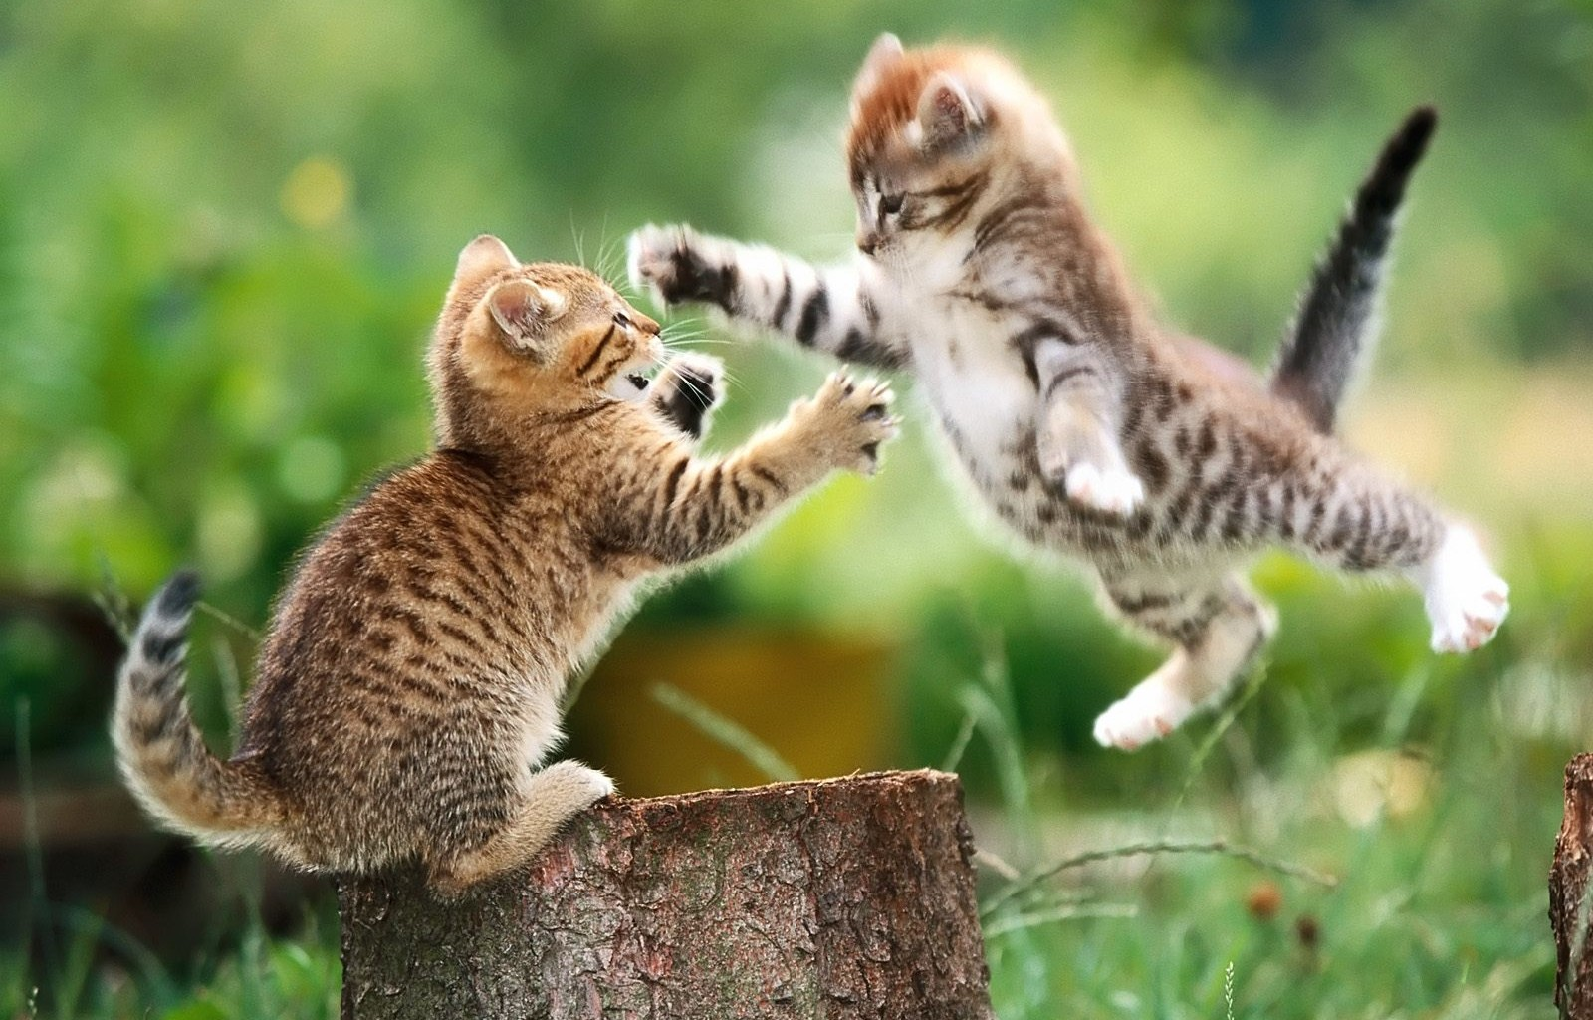
TITLE OF POSTER (PS - If you can’t read the tiny print… Zoom in!)
Presenter Name, Credentials
Institution
Abstract
It is best to use the abstract that you submitted to the proceedings so that there is no confusion. This box will expand to fit the information you share. Background colors can be changed by going to Shape Format and changing the color fill – be sure you don’t go crazy with the color palate. These boxes can be adjusted in whatever way makes the most sense given their sizes.
GENERAL FONT Do’s:
Use either a dark (black) text on a lighter background OR a white font on a dark background. Keep colors consistent and make sure they do not class (e.g. blue background with red font).
Keep the font clean and simple (sans-serif usually best). Don’t use any hard-to-read fonts. The font used for this example is Calibri.
Another commonly used font is Arial (as seen here).
Description / Method
Be sure to describe what you did concisely and clearly. Again, you don’t have a whole lot of space to do this.
You can also use things like tables and Smart Art (under the Insert tab – see below for an example) to create interesting visuals for your description / methods.
Subheadings – These can be useful for organizing your steps and ideas. You can use written information.
You can also use bullets or numbers – This is another way to organize your ideas.
Refer to tables in your text, but as with tables in a full paper, the table provided on the poster should stand alone, without the benefit of reading the poster (readers could just read the table and nothing else and should be able to understand it).
Use whatever combination of images, tables, figures, Smart Art, etc. needed to convey your message clearly.
Results / Outcomes
Provide information about the results you found as part of your research. This information can also be divided up using subheadings if it makes sense.
You can also change up the number of columns, but probably should not be more than four (4). It may be that having more makes sense given your information. Or if you have multiple tables, moving around sections may help your reader follow your flow. You can copy/paste these sections and then edit them. You can also divide up sections – indicate (continued) next to a continuation of a particular section.
You might also want to put together a one-sheet with a summary of your poster that attendees can take with them.
Conclusion
Sum up your ideas/thoughts here. What is your “take home” message for readers?
This section should be brief and you can even use bullets or numbers to list out your points.
When you’re done, save this file as a PDF. This will make it easier for printing, unless where you are planning on getting the poster printed says otherwise.
Introduction
You may choose to indent your paragraphs or add extra spaces in between each separate paragraph. Whatever might look better (examples of each are provided, choose the style you like best). This box can expand to fit the content. You can change the background color – see above.
Keep the content relevant but generally brief as you do not have as much room as you might with a full paper, for example. Be sure it explains why you conducted your study or research.
References would be appropriate here to ground your topic in the body of research.
.
Table 1: Example Table. See the table formatting guidelines in the Author Information packet for details on how to construct a table.
Header | Value 1 | Value 2
This table | Has no fill in | The background
The background | Is a shape | And had a fill color
You can also | Choose a different | Table Design
See the tab | At the top | Of the Ribbon
Be sure to keep | Information in a | Table clear and
Uncluttered | You can also change | The fill of certain
Columns or rows
Notes can go down here. These could be explanations for shorthand or other specifics that are important for understanding the content of the table.
References
Author Year format should be used for references
If you need to adjust the size of the font in this section, that is okay
If you wrote a paper, but only used some of those references in the poster, just use the references cited in the poster directly
Step One
Think about your process
Step Two
Keep the steps brief
List out the steps
Step Three
You can have indented sub-steps
Consider which Smart Art design would work best for what you want to convey
You can add as many headings as make sense
Don’t go overboard, though!
The colors and designs can be changed to fit your theme.
Font sizes can also be changed.
This Photo by Unknown Author is licensed under CC BY-SA-NC
Figure 1: Ferocious. This image came from the Creative Commons (see the credit example below the picture). You should always use images that either you took or you have permission to use. Attribute the image to the photographer or institution. NEVER use a copyrighted image. Make sure the image is of high enough quality that it will print clearly.
Figure 2: Smart Art. A description should be included for any Smart Art used. As with images or figures, the description and art should be stand alone

